Slide 1

Information Technology
Sujay purkait

Slide 2
Information Technology?
Definition: The use of computers, storage, networking, and other physical devices, infrastructure, and processes to create, process, store, secure, and exchange all forms of electronic data.
Types: Hardware, Software, Networks, Data.

Slide 3
The Role of IT in Business Operations :
How does IT actually help a business run? It's not just about saving money on paper. It's about speed and accuracy. Think about a global supply chain; without IT, tracking a shipment from Shanghai to New York would be a nightmare of phone calls and spreadsheets. IT automates the mundane so humans can focus on strategy. It turns "waiting" into "instant."

Slide 4
Overview of Business Systems (ERP & CRM)
ERP (Enterprise Resource Planning): The central nervous system (Finance, HR, Supply Chain).
CRM (Customer Relationship Management): The face of the business (Sales, Support, Marketing).

Slide 5
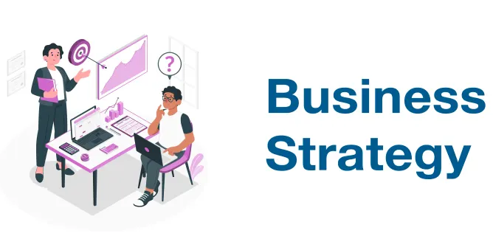
The Interplay Between IT and Business Strategy :
The biggest mistake companies make is treating IT as an afterthought. True strategy means asking: "how can technology help us beat our competitors?" It's not about buying the newest software; it's about using technology to enter new markets or create new business models. IT and business strategy must dance together; if one leads and the other follows, the company falls.

Slide 6
Recap & Discussion
IT is the foundation of modern operations.
Systems like ERP/CRM are critical.
Alignment is key to success.

Slide 7

Understanding Different Data Types
Structured
Unstructured
Semi-structured

Slide 8
Structured Data
Definition: Highly organized data that fits neatly into fixed relational tables.
Format: Rows and columns with predefined data types (e.g., Text, Dates, Integers).
Technologies: SQL databases, Microsoft Excel, PostgreSQL.
Business Example: Customer transaction histories, inventory counts, employee IDs.

Slide 9
Unstructured Data
Definition: Data that lacks a predefined conceptual framework or data model.
Volume: Comprises roughly 80% to 90% of all newly generated enterprise data.
Technologies: NoSQL databases, Data Lakes (e.g., AWS S3, Azure Blob Storage).
Business Example: Customer service call recordings, PDF contracts, marketing videos.

Slide 10
Semi-Structured Data
Definition: Data with organizational markers but no rigid, relational schema.
Self-Describing: Uses tags or hierarchies to separate data elements.
Technologies: NoSQL databases (e.g., MongoDB), web-based data protocols.
Business Example: JSON logs, XML files, email messages (metadata + unstructured body).

Slide 11
Common Data Sources
Internal: Transaction logs, HR records, internal reports.
External: Market research, social media, government stats.
APIs: Connecting different software applications.
Databases: The storage vaults.

Slide 12
Databases vs. APIs
Static Storage vs. Real-Time Pipelines :
Databases: Persistent, internal storage engines holding historical records.
Database Function: Batch processing and deep historical querying.
APIs (Application Programming Interfaces): Live software-to-software pipelines.
API Function: Real-time data streaming (e.g., fetching live currency conversion rates).

Slide 13
Passive Sensing vs. Active Engagement
Passive Sensing: Continuous, automated collection requiring minimal user effort.
Passive Examples: IoT sensor networks, website cookies, GPS tracking logs.
Active Engagement: Targeted information gathering reliant on direct human input.
Active Examples: Customer feedback surveys, manual forms, focus group interviews.

Slide 14
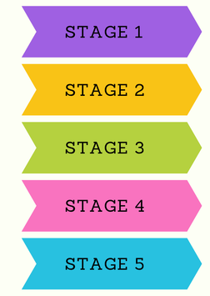
Data Lifecycle Management (DLM):
The 5 Stages of Data Architecture

Slide 15
Stage 1 & Stage 2: Creation and Storage
1. Creation: The initial entry point via manual input, sensing, or buying.
Creation Risk: Input errors at this phase corrupt all later lifecycle steps.
2. Storage: Depositing raw or processed info into secure digital architectures.
Storage Focus: Implementing access permissions, encryption, and redundancy backups.

Slide 16
Stage 3 & Stage 4: Usage and Archiving
3. Usage: Accessing information to power applications, reports, and algorithms.
Usage Focus: Preventing data leaks while optimizing performance for business analysts.
4. Archiving: Moving inactive data out of expensive primary storage pools.
Archiving Focus: Retaining historical records in cheap cold storage for legal audit trails.

Slide 17
Stage 5: Deletion
5. Deletion: Programmatically destroying information when it hits expiration limits.
Compliance Mandate: Required by modern laws (e.g., GDPR's "Right to be Forgotten").
Execution Rule: Overwriting storage sectors so records cannot be recovered by hackers.

Slide 18
Data Quality and Integrity
Business Hazard: Bad data leads to bad choices ("Garbage In, Garbage Out").
Financial Drag: Poor data quality costs companies billions annually in wasted operations.

Slide 19
The Three Pillars: Accuracy, Completeness, Consistency
Accuracy: Does the recorded digital value match the physical reality?
Completeness: Are all critical, required fields filled out within the system?
Consistency: Do records matching across separate regional databases show the identical value?

Slide 20
Data Integrity and Validation Controls
Data Integrity: Ensuring information remains unaltered during storage or transfer.
Input Validation: Restricting what users can type into a data field (e.g., letters only).
Referential Integrity: Ensuring relational database links remain unbroken across tables.

Slide 21
Recap & Discussion
BA is the bridge between business and tech.
Soft skills (communication) are as important as hard skills.
Methodologies (Agile vs. Waterfall) dictate workflow.
Stakeholder management is critical for success.

Slide 22
Distinguishing Raw Data from Processed Information
Let's clear up a common confusion. Data is just raw material. "38" is just a number. But "38 degrees Celsius" is information. And "Patient A has a fever of 38 degrees" is knowledge. Data becomes information when you add context. Without context, data is noise.
Data: Raw facts, numbers, symbols (e.g., "38, 98, 102").
Information: Data with context and meaning (e.g., "Patient temperatures: 38, 98, 102").

Slide 23
The Transformation Process: Data to Information
Collection: Gathering raw data.
Processing: Cleaning, sorting, calculating.
Contextualization: Adding meaning (Who? When? Where?).
Visualization: Making it readable.

Slide 24
From Information to Knowledge
Information: "Sales dropped 10% in Q3."
Knowledge: "Sales dropped because of the competitor's new product launch."
Wisdom: "We need to innovate our pricing strategy to compete."

Slide 25
The Value of Information in Decision Making
Reducing uncertainty.
Identifying trends and patterns.
Supporting evidence-based decisions.
Avoiding "gut feeling" decisions.

Slide 26
Data to Action
Scenario: Retail store noticing a drop in foot traffic.
Data: Foot traffic counters show -15%.
Information: Drop correlates with a new competitor opening nearby.
Action: Launch a targeted loyalty campaign

Slide 27
Definition of Data-Driven Decision Making
Definition: The practice of basing decisions on the analysis of data rather than intuition alone.
Types: Descriptive, Diagnostic, Predictive, Prescriptive.
Features: Evidence-based, Measurable, Repeatable.
Objective: To improve organizational outcomes through objective analysis.

Slide 28
Principles of DDDM
Definition: The foundational rules guiding data-driven organizations.
Types: Data Accessibility, Data Quality, Cultural Support, Continuous Improvement.
Features: Transparency, Accountability, Collaboration.
Objective: To create a sustainable environment for data usage.

Slide 29
Benefits of Using Data for Decisions
Definition: The positive outcomes of adopting DDDM.
Types: Increased Efficiency, Better Customer Insights, Risk Mitigation, Innovation.
Features: Quantifiable ROI, Competitive Edge.
Objective: To demonstrate the tangible value of data analytics.

Slide 30
Steps in the DDDM Process
Definition: The workflow for executing data-driven decisions.
Steps: Define Problem → Collect Data → Analyze → Interpret → Decide → Monitor.
Features: Cyclical, Iterative, Feedback-driven.
Objective: To provide a structured approach to problem-solving.

Slide 31
Analytics Maturity Model – From Descriptive to Prescriptive
Descriptive Analytics: What happened? (Reports, Dashboards)
Diagnostic Analytics: Why did it happen? (Drill-downs, Data Mining)
Predictive Analytics: What will happen? (Statistical Forecasting, ML Models)
Prescriptive Analytics: What should we do about it? (Optimization, Simulation)

Slide 32
Challenges and Pitfalls
Definition: Common obstacles in implementing DDDM.
Types: Data Silos, Poor Quality, Analysis Paralysis, Confirmation Bias.
Features: Resistance to change, Technical debt, Misinterpretation.
Objective: To identify and mitigate risks in data adoption.

Slide 33
Real-Life Example: Netflix Recommendation Engine
Definition: Case study of DDDM in action.
Scenario: Using viewing data to recommend content.
Features: Personalization, Retention, Cost Reduction.
Objective: To showcase the power of data in customer experience.

Slide 34
Cultural Obstacles to DDDM
HiPPO Effect: (Highest Paid Person's Opinion) overriding empirical data.
Siloed Data: Departments hiding data, preventing enterprise-wide insights.
Data Literacy Gap: Employees lacking confidence to read and interpret charts correctly.

Slide 35
What is Data Governance?
Definition: The overall management of the availability, usability, integrity, and security of enterprise data assets.
Core Goals: Ensure high data quality, minimize legal liabilities, break down data silos, and protect sensitive information.

Slide 36
Key Pillars of Data Governance
Data Stewardship: Assigning business owners responsible for specific data domains (e.g., Customer Data Steward).
Data Architecture & Standards: Uniform definitions, naming conventions, and metadata management.
Security & Access Control: Role-Based Access Control (RBAC), multi-factor authentication, encryption standard enforcement.

Slide 37
Introduction to Data Ethics
Definition: A branch of ethics that evaluates moral problems related to data collection, algorithmic processing, and information use.
Key Question: Just because we CAN collect this data, SHOULD we?

Slide 38
Core Ethical Principles – Privacy & Confidentiality
Data Minimization: Collect only the data strictly necessary for the intended purpose.
Confidentiality: Protecting sensitive user records (PII - Personally Identifiable Information) from unauthorized eyes.
Consent: Ensuring users explicitly opt-in with a clear understanding of how their data will be used.

Slide 39
Core Ethical Principles – Transparency & Algorithmic Bias
Transparency: Clearly explaining how algorithms use customer data to make automated decisions (e.g., loan approvals).
Algorithmic Bias: Preventing historical biases in training data from causing discrimination based on race, gender, or age in AI/ML outputs.

Slide 40
Regulatory Compliance – GDPR (General Data Protection Regulation)
Scope: EU regulation with global impact (applies to anyone processing EU resident data).
Key Rights:
Right to be Forgotten (Data Erasure).
Right to Access & Data Portability.
Penalties: Up to €20M or 4% of global annual turnover.

Slide 41
Building a Responsible Data Culture
Continuous employee training on data privacy and security threats (phishing, social engineering).
Establishing an Ethics Board to review automated models and data initiatives.
Creating safe whistleblowing channels for reporting data abuses.

Slide 42
Course Summary & Capstone Framework
IT provides infrastructure and business systems (ERP, CRM).
Data flows through a structured lifecycle and requires governance to maintain high quality.
BAs convert raw data into insights, steering data-driven decisions while keeping ethics and compliance at the center.

Slide 43
Enterprise Architecture (EA) Frameworks
Definition: EA aligns business goals with IT strategy, software architectures, and infrastructure.
TOGAF (The Open Group Architecture Framework): Business, Data, Application, and Technology Architectures.
Zachman Framework: A 6x6 matrix defining perspectives (Executive to Developer) against questions (What, How, Where, Who, When, Why).

Slide 44
Integration Patterns – Middleware & APIs
Point-to-Point vs. Middleware: Spaghetti integration vs. Enterprise Service Bus (ESB) and microservices.
API Protocols: REST (JSON-based, lightweight) vs. SOAP (XML-based, strict security standards).
Event-Driven Architecture: Asynchronous data processing using message brokers (e.g., Apache Kafka, RabbitMQ)

Slide 45
Cloud Infrastructure Models – IaaS, PaaS, and SaaS
Infrastructure as a Service (IaaS): Raw computing power and storage (e.g., AWS EC2, Azure VMs).
Platform as a Service (PaaS): Managed runtime environments for developers (e.g., AWS Elastic Beanstalk, Heroku).
Software as a Service (SaaS): Ready-to-use business software (e.g., Salesforce, Microsoft 365).

Slide 46
Cloud vs. On-Premises vs. Hybrid Environments
On-Premises: Total control over hardware and security; high capital expenditure (CapEx).
Public Cloud: High elasticity, operational expenditure model (OpEx), third-party dependency.
Hybrid Cloud: Sensitive data stays on-premises; scalable workloads run in the public cloud.

Slide 47
Legacy System Modernization
The Legacy Dilemma: Systems that are mission-critical but run on outdated, difficult-to-maintain technology.
Modernization Strategies (The 5 Rs): Rehost (Lift & Shift), Refactor, Replatform, Rearchitect, Replace.
Business Impact: Risk reduction, increased performance, and lower maintenance costs.

Slide 48
Big Data Fundamentals – The 5 Vs
Volume: Scale of data (terabytes to zettabytes).
Velocity: Speed at which data arrives and streams in real time.
Variety: Diversity of data formats (structured, unstructured, audio, video).
Veracity: Trustworthiness and reliability of incoming data.
Value: Turning raw processing capacity into financial/operational return.

Slide 49
Data Integration Pipelines – ETL vs. ELT
ETL (Extract, Transform, Load): Data is transformed on a secondary server before hitting the storage target (ideal for traditional Data Warehouses).
ELT (Extract, Load, Transform): Raw data is loaded straight into modern cloud storage and transformed in-place using cloud compute engines (e.g., Snowflake, BigQuery).

Slide 50
Data Warehouses vs. Data Lakes vs. Data Lakehouses
Data Warehouse: Relational, schema-on-write, optimized for fast SQL queries and business intelligence.
Data Lake: Object storage, schema-on-read, holds raw unstructured data for data science and ML.
Data Lakehouse: Combines the low-cost storage of Data Lakes with the ACID transaction reliability of Data Warehouses (e.g., Databricks).

Slide 51
Master Data Management (MDM)
What is MDM? Processes and tools that consistently define and manage non-transactional key data entities (Customer, Product, Supplier).
Problem Solved: Prevents redundant customer records across marketing, billing, and support databases.
Key Output: Golden Records.

Slide 52
Data Security & Encryption Standards
Encryption at Rest: Protecting stored files using AES-256 standards.
Encryption in Transit: Securing networks using TLS/SSL protocols.
Data Masking & Anonymization: Redacting PII in non-production development environments.

Slide 53
The IIBA BABOK Framework Overview
Business Analysis Planning & Monitoring.
Elicitation & Collaboration.
Requirements Life Cycle Management.
Strategy Analysis, Requirements Analysis & Design Definition, Solution Evaluation.

Slide 54
Writing Effective Requirements – User Stories & Acceptance Criteria
User Story Structure: "As a [User Role], I want to [Perform Action], So that [Receive Benefit]."
INVEST Criteria: Independent, Negotiable, Valuable, Estimable, Small, Testable.
Acceptance Criteria: Given-When-Then format establishing explicit definition of done.

Slide 55
Prototyping and Wireframing Techniques
Low-Fidelity: Paper sketches, basic whiteboard flows for quick validation.
High-Fidelity: Interactive screen prototypes created in tools like Figma or Axure.
Benefits: Reduces scope creep by clarifying user interfaces before coding starts.

Slide 56
User Acceptance Testing (UAT) Management
BA Role in UAT: Writing test scripts based on business requirements, coordinating business end-users, and tracking defects.
Objective: Confirming that the software works as intended in real-world operational scenarios.

Slide 57
organizational Change Management (OCM)
Why Systems Fail: Technical delivery succeeds, but end-users resist changing their workflow.
ADKAR Model: Awareness of need for change, Desire to support it, Knowledge of how to change, Ability to execute, Reinforcement to sustain.

Slide 58
Metadata & Data Lineage
Metadata: "Data about data" (file size, creation timestamp, author, schema definitions).
Data Lineage: Mapping the lifecycle of a data point from original source, through transformations, to final reporting dashboard.
Value: Essential for compliance auditing and debugging data discrepancies.

Slide 59
Defining Key Performance Indicators (KPIs)
Lagging Indicators: Measure past results (e.g., Quarterly Net Profit).
Leading Indicators: Predict future performance (e.g., Customer Engagement Index).
SMART Rule: Metrics must be Specific, Measurable, Achievable, Relevant, and Time-bound.

Slide 60
Executive Dashboards vs. Operational Reports
Executive Dashboards: High-level summary visuals, strategic metrics, updated daily/weekly.
Operational Reports: Granular detail, real-time transaction logs, used by front-line staff for daily operations.

Slide 61
Advanced Diagnostic Analytics Techniques
Drill-Down Analysis: Moving from summary charts into underlying transaction records.
Data Mining: Discovering hidden associations or anomalies across large datasets.
Correlation vs. Causation: Ensuring two parallel trends are actually cause-and-effect before taking action.

Slide 62
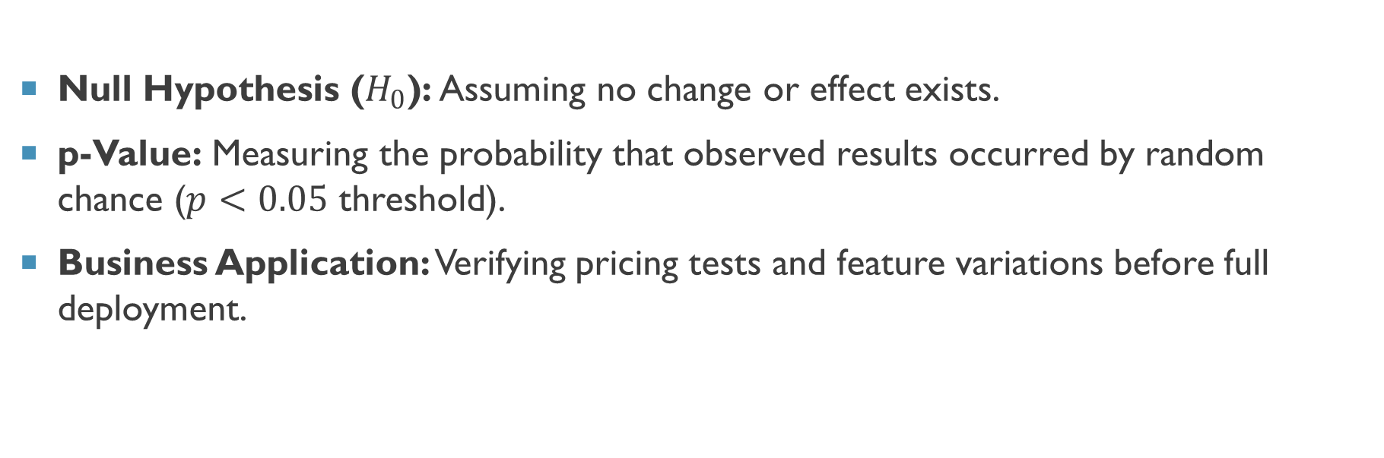
Hypothesis Testing & Statistical Significance in Business
Null Hypothesis ($H_{0}$): Assuming no change or effect exists.
p-Value: Measuring the probability that observed results occurred by random chance ($p<0.05$ threshold).
Business Application: Verifying pricing tests and feature variations before full deployment.

Slide 63
Root Cause Analysis (RCA) Frameworks
5 Whys Technique: Iteratively asking "Why" 5 times to peel away symptom layers.
Ishikawa / Fishbone Diagram: Categorizing causes into People, Process, Technology, Environment, and Materials.
Pareto Analysis (80/20 Rule): Identifying the 20% of causes responsible for 80% of business bottlenecks.

Slide 64
Prescriptive Analytics & Decision Automation
Simulation & Optimization: Modeling complex supply chains under varying demand assumptions.
Rule Engine Automation: Systems making real-time, micro-decisions without human intervention (e.g., instant credit scoring).

Slide 65
Cross-Border Data Transfers & Data Sovereignty
Data Localization Laws: Regulations requiring customer data to remain physically inside national borders (e.g., India, China, EU).
Impact on IT Architecture: Designing multi-region databases and localized cloud storage to comply with international laws.

Slide 66
Responsible AI & Ethics in Business Systems
Explainable AI (XAI): Ensuring complex deep learning models can explain why a customer was denied credit or rejected.
Human-in-the-Loop (HITL): Maintaining human oversight on high-stakes AI outputs (e.g., healthcare diagnostics, legal reviews).

Slide 67

Thank You
Sujay purkait

